Slide 1
Image Steganography: Secure Text Encryption in Images Using Python
CAPSTONE PROJECT
Presented By
Chaitali Uday Patil
College Name: Dr. D Y Patil School of MCA, Pune
Department : Computer Application

Slide 2
OUTLINE
Problem Statement
Technology used
Wow factor
End users
Result
Conclusion
Git-hub Link
Future scope

Slide 3
Problem Statement
In today’s digital era, data privacy and secure communication are critical.
Traditional encryption methods can raise suspicion, making hidden communication vulnerable.
The challenge is to develop a system that securely hides messages within images, making the existence of the message itself undetectable.
Ensuring secure communication without raising suspicion is a significant challenge in modern data transmission.
Traditional encryption methods are detectable.
This project focuses on hiding secret messages inside images using Python-based image steganography techniques, providing an undetectable way to secure sensitive information.

Slide 4
Technology used
Programming Language: Python
Library: OpenCV
Development Environment: Vscode, Jupyter notebook
File Format: PNG and JPG for encrypted images

Slide 5
Wow factors
Hidden in Plain Sight: Secret messages hidden inside the blue channel of image pixels without visible changes.
Lightweight & Fast: Rapid encryption process using native Python.
Password-Protected Encryption: Messages are secured with user-defined passwords.
No Visual Difference: The carrier image looks identical to the original, making detection difficult.

Slide 6
End users
Cybersecurity Enthusiasts – Exploring secure communication techniques.
Government & Defense – Secure message transmission without raising suspicion.
Journalists & Activists – Concealing sensitive information in images to avoid surveillance.
Software Developers – Learning steganography concepts and their applications.

Slide 7
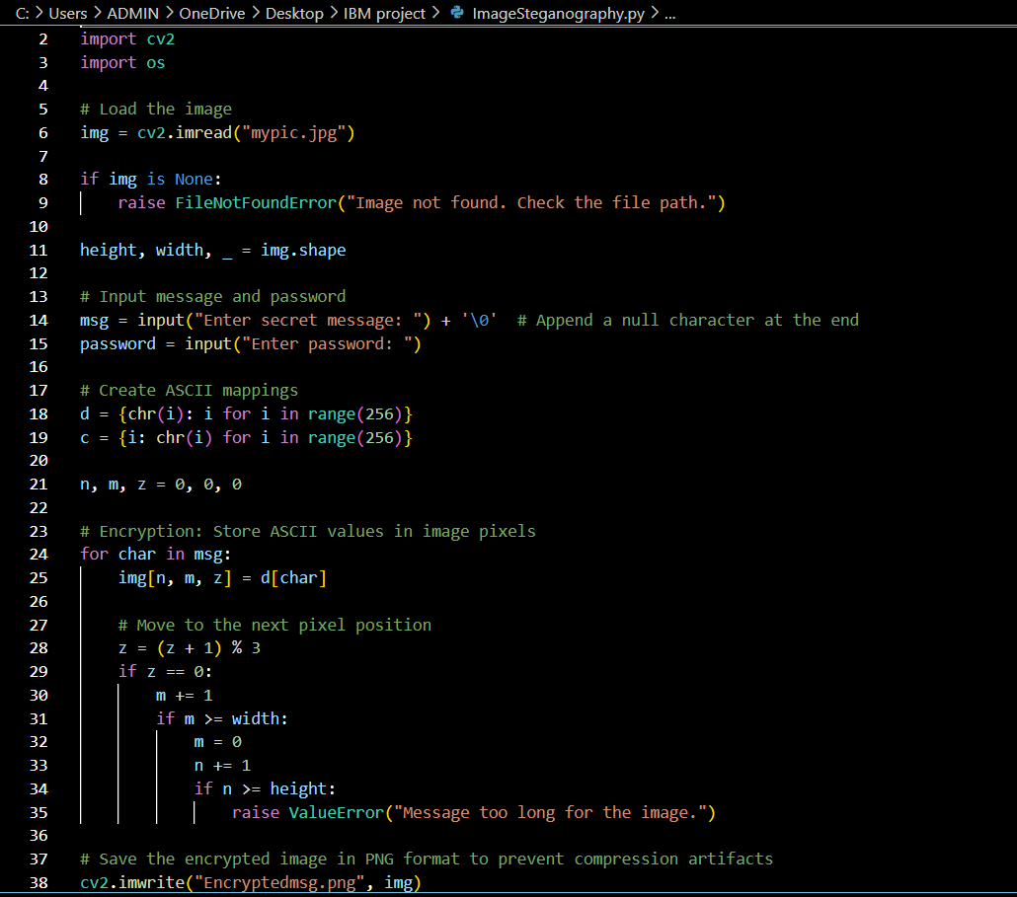
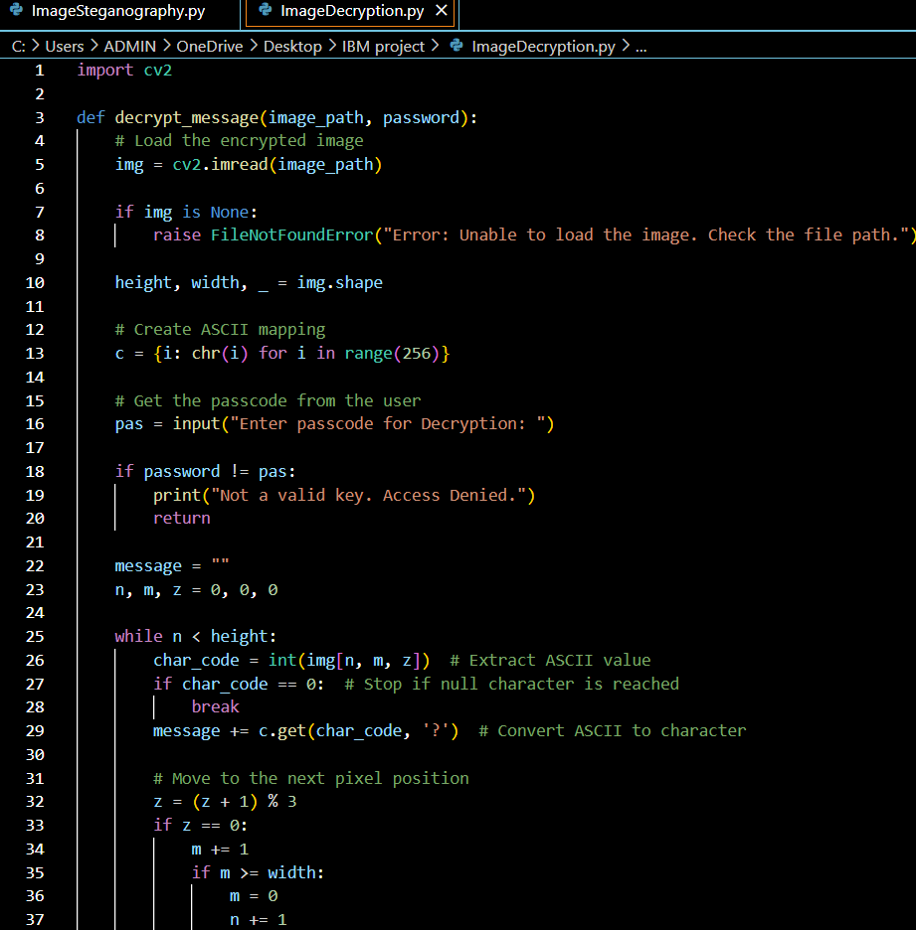
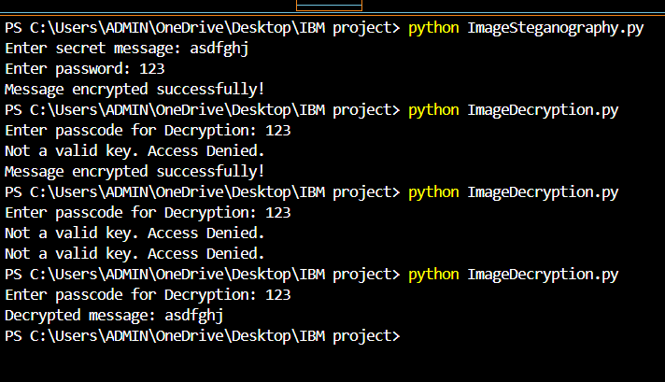
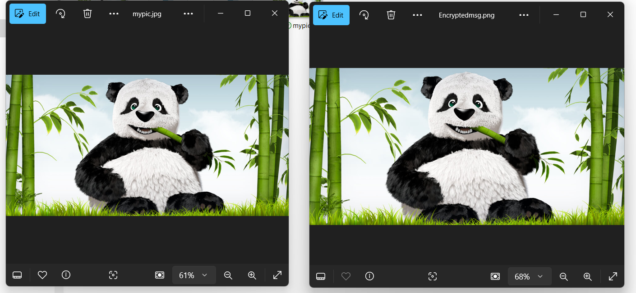
Results
Encryption Code:
Decryption Code:
Output:
Input Image File
Output Image File

Slide 8
Conclusion
Steganography provides a covert way of communicating sensitive information.
This project showcases a simple yet effective implementation of message hiding in images.
Future improvements can make it more robust, secure, and scalable.

Slide 9
GitHub Link
https://github.com/Chaitalipatil1403/SteganographyProject.git

Slide 10
Future scope
Support for Multiple File Formats: Extend functionality to support audio, video, and PDF files for broader steganography applications.
Advanced Encryption: Integrate AES or RSA encryption for additional security layers.
GUI Integration: Develop a user-friendly graphical interface for enhanced usability.
Compression Techniques: Optimize storage by integrating compression algorithms.
Cross-Platform Application: Expand the application to Android and web platforms for broader accessibility.
Robust Steganalysis Resistance: Implement techniques to resist detection by steganalysis tools, improving the security of the hidden data.

Slide 11
THANK YOU

